Slide 1
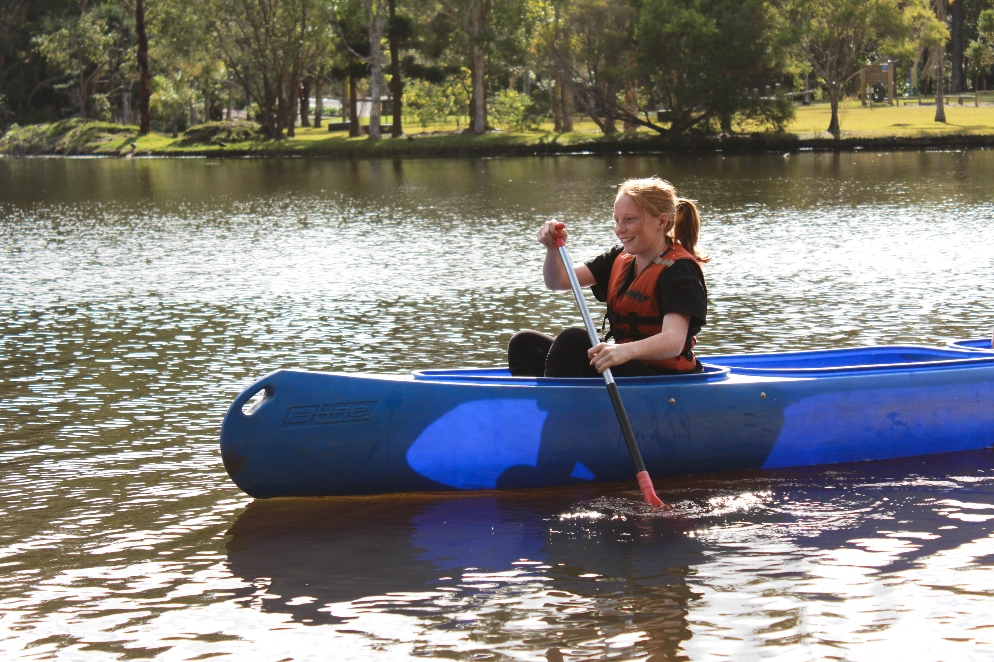
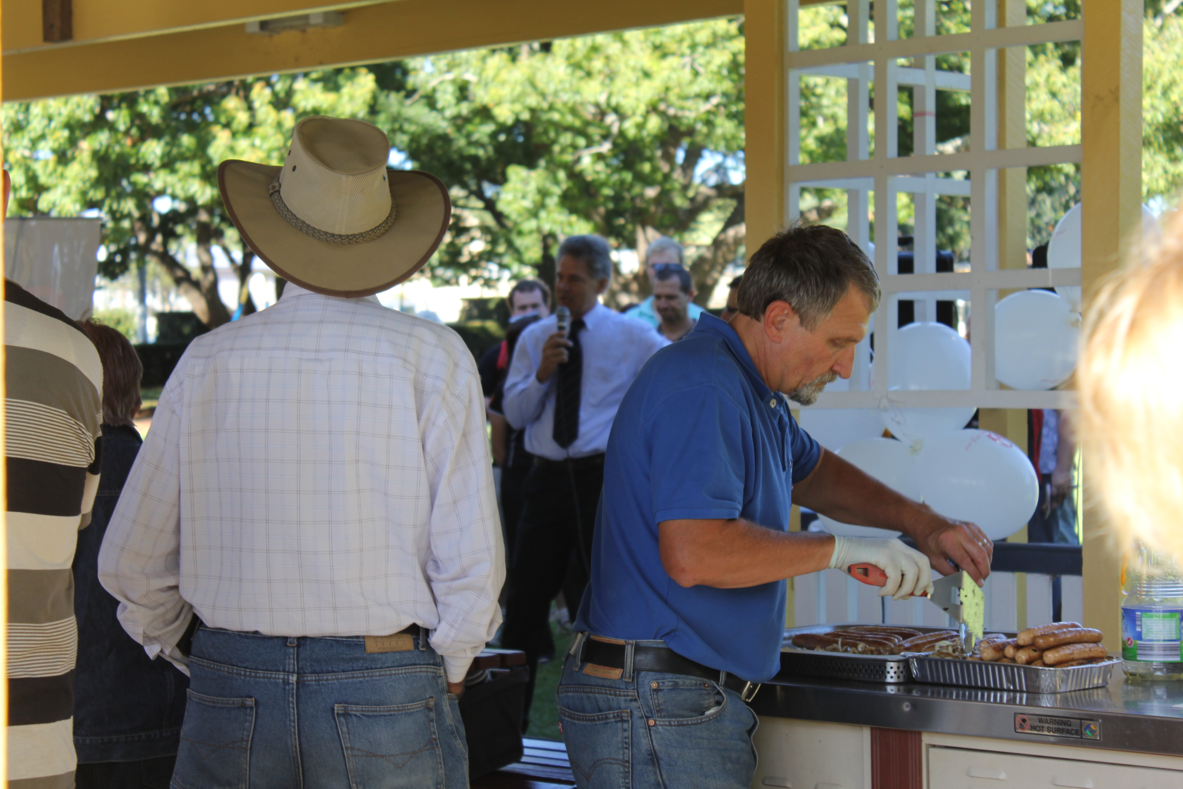
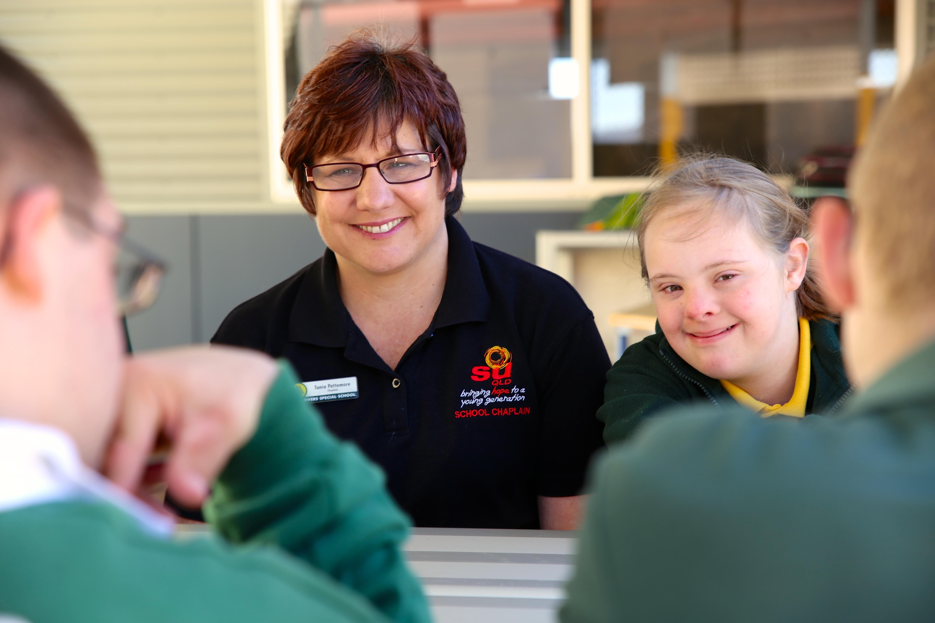
THE IMPACT OF CHAPLAINCY

Slide 2
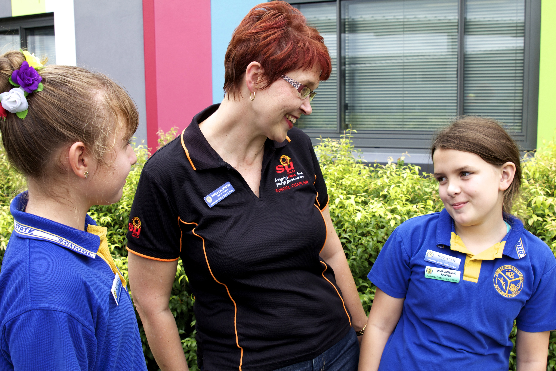
^{The unique dimensions of}
^{School Chaplaincy} ^{include:}
1. Holistic care of student and families
2. The Local Chaplaincy Committee
^{(LCC)}
^{3. Rich networks}
^{4. SU QLD support}
SU QLD Chaplaincy has built a solid reputation in Queensland over 25 years. We are the largest provider of school chaplains serving over 385,000 students in more than 800 schools.

Slide 4
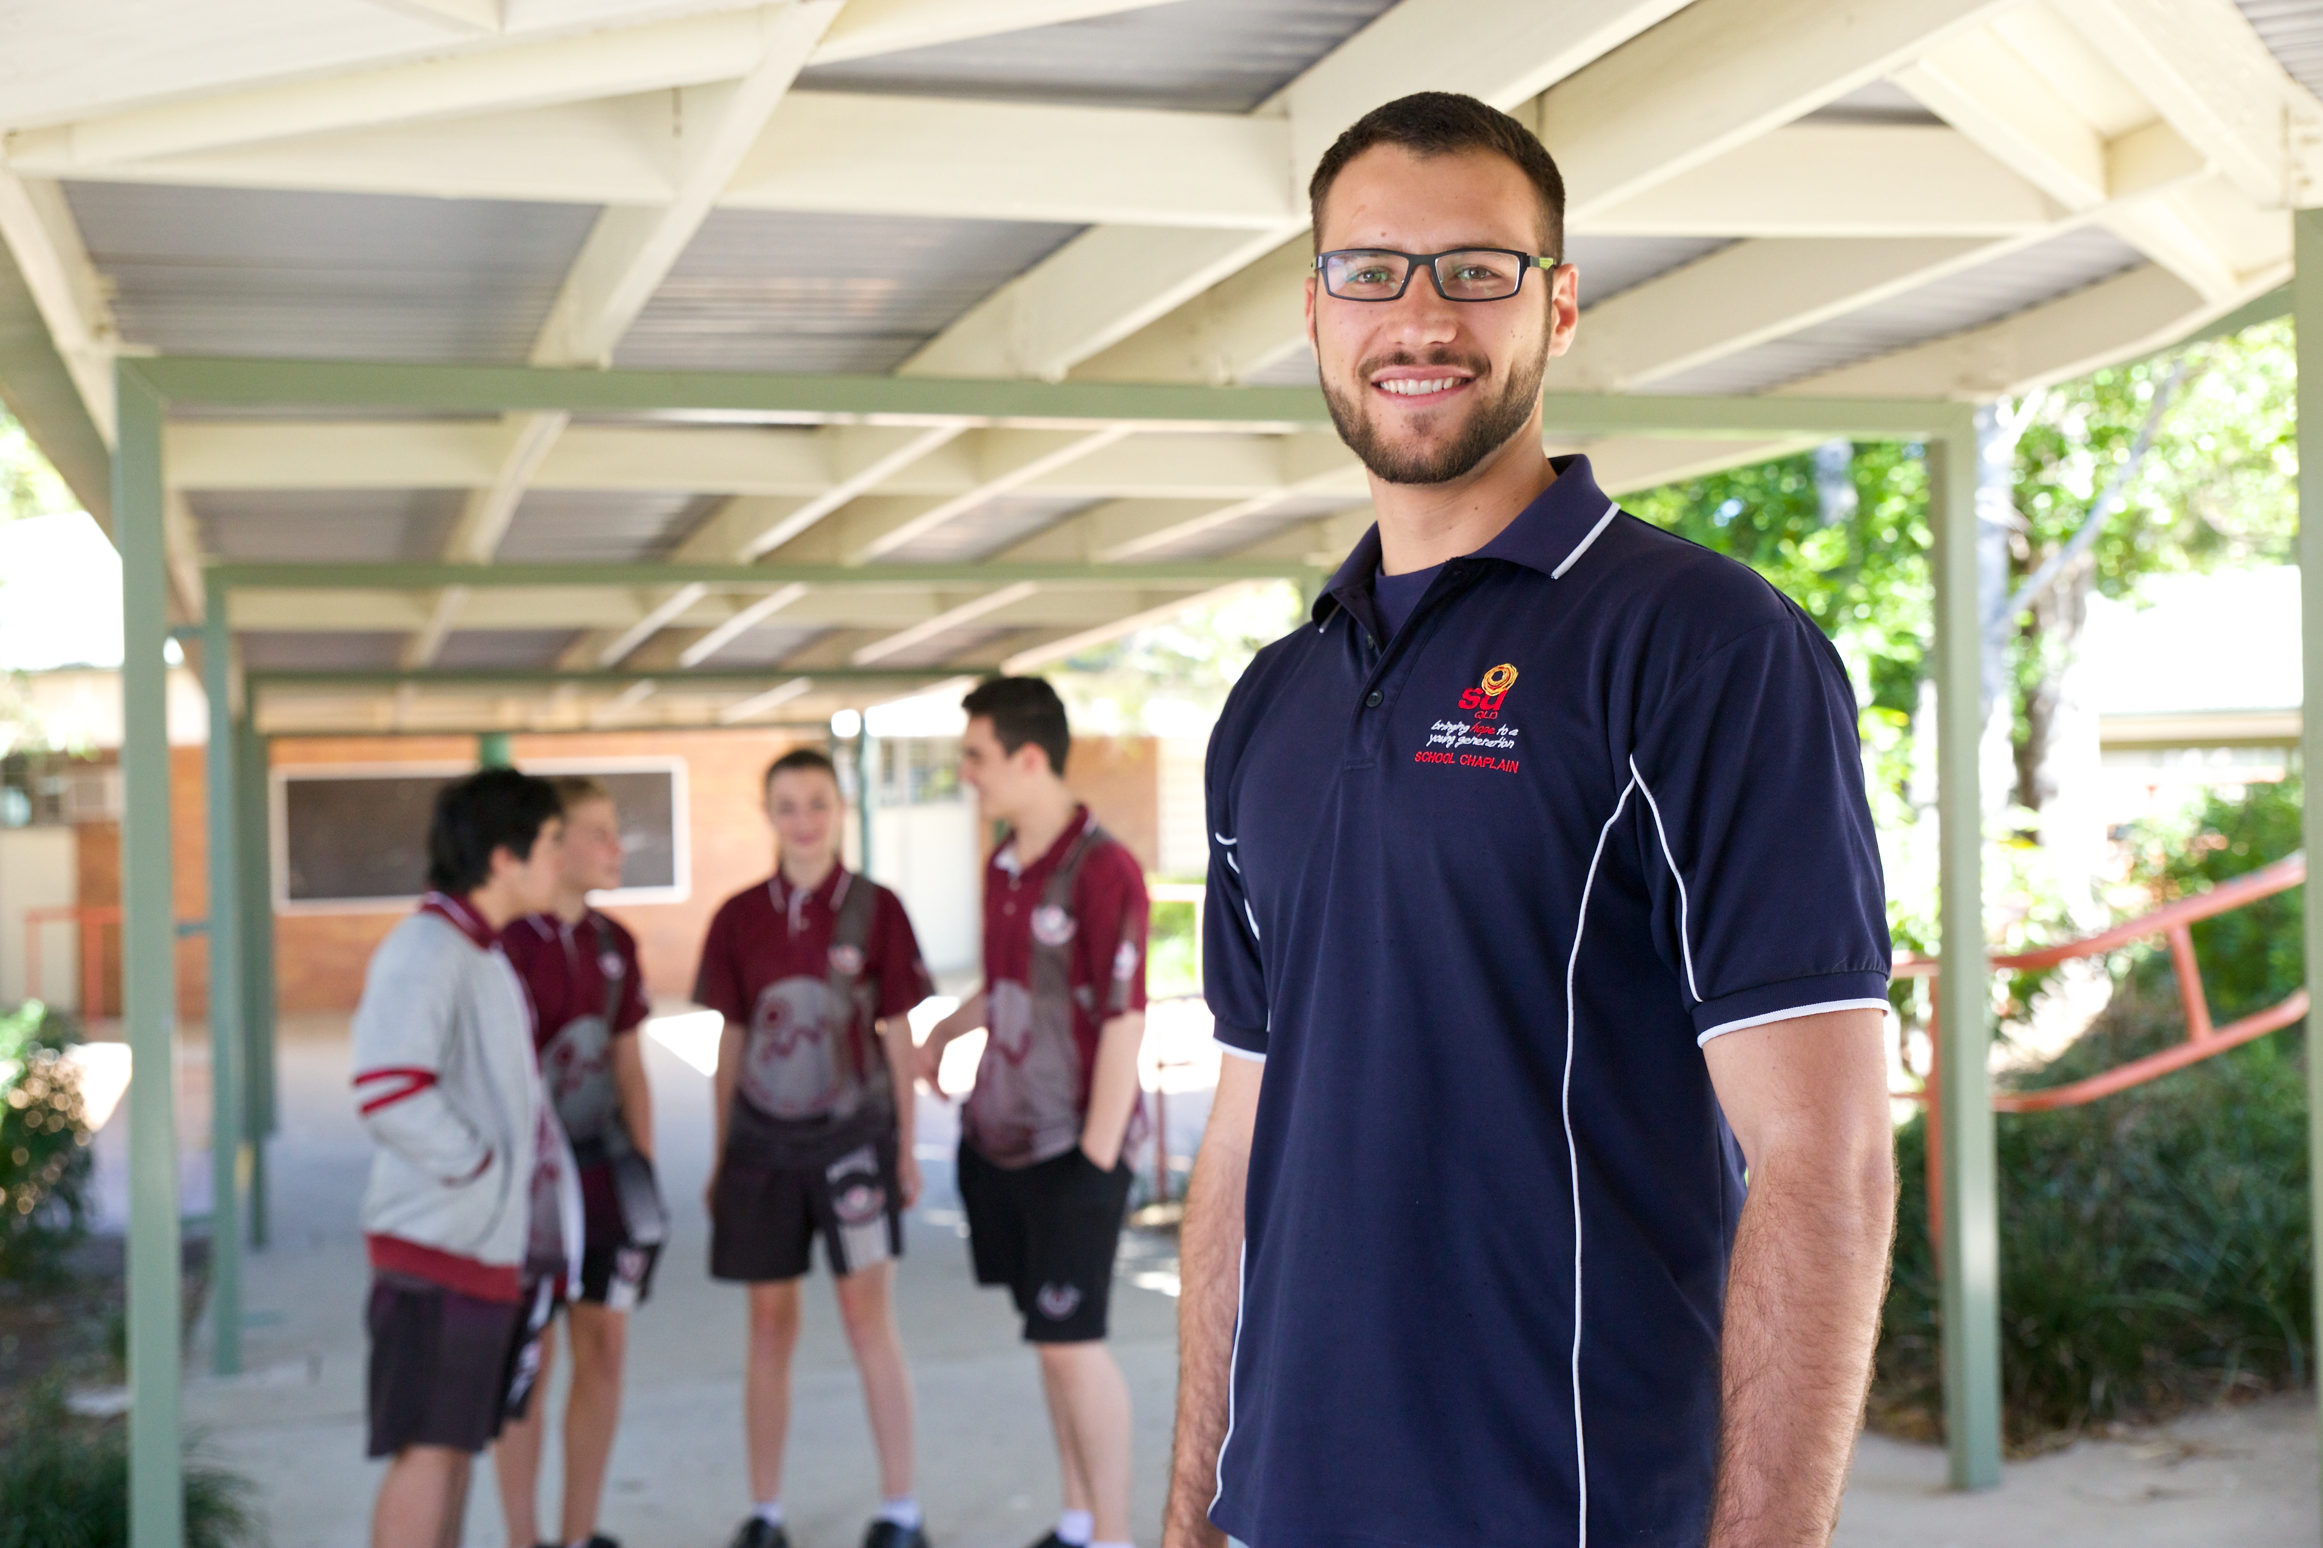
The role of a chaplain
The role of a school chaplain is to provide social, emotional and spiritual support to
students, parents and staff taking into account the specific needs of the school.
They are in the prevention and support business helping students find a better way to
^{deal with issues.}
They provide a listening ear and a caring presence for kids in crisis.
They provide support for staff and parents in school communities.

Slide 5
What chaplains do
- Wellbeing Programs
Please view video here:
https://www.youtube.com/watch?v=68HObyvsKSk&list=PLDC43542E70FA7CDB
Notes:
Please view video here: https://www.youtube.com/watch?v=68HObyvsKSk&list=PLDC43542E70FA7CDB

Slide 6
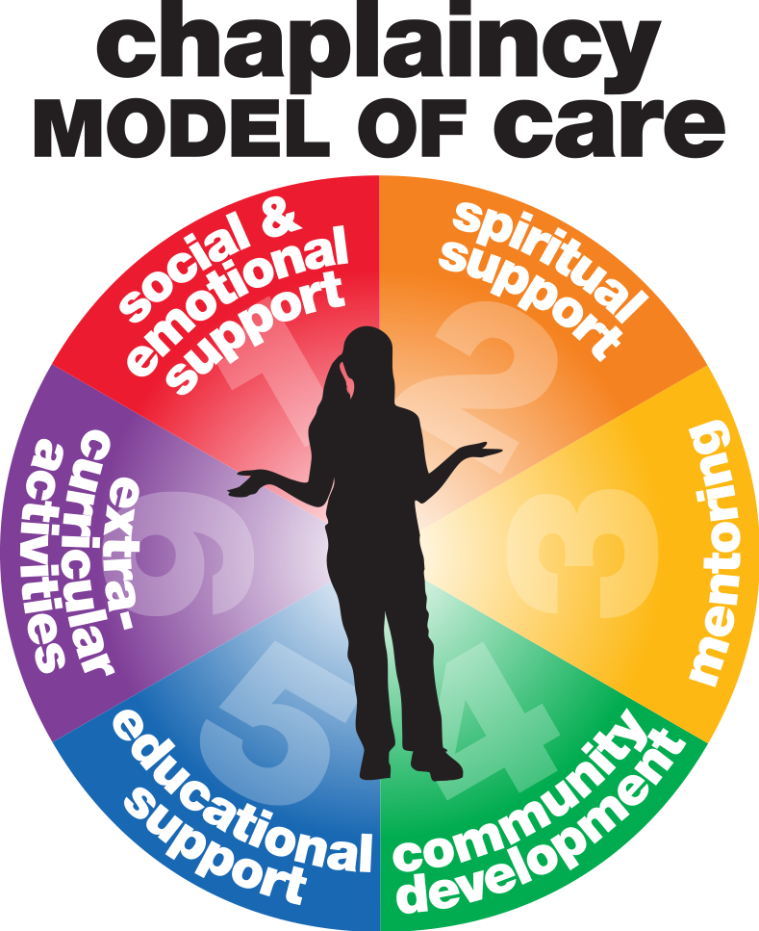
Chaplains play an invaluable role within a school community, working with other school
staff to provide:

Slide 7
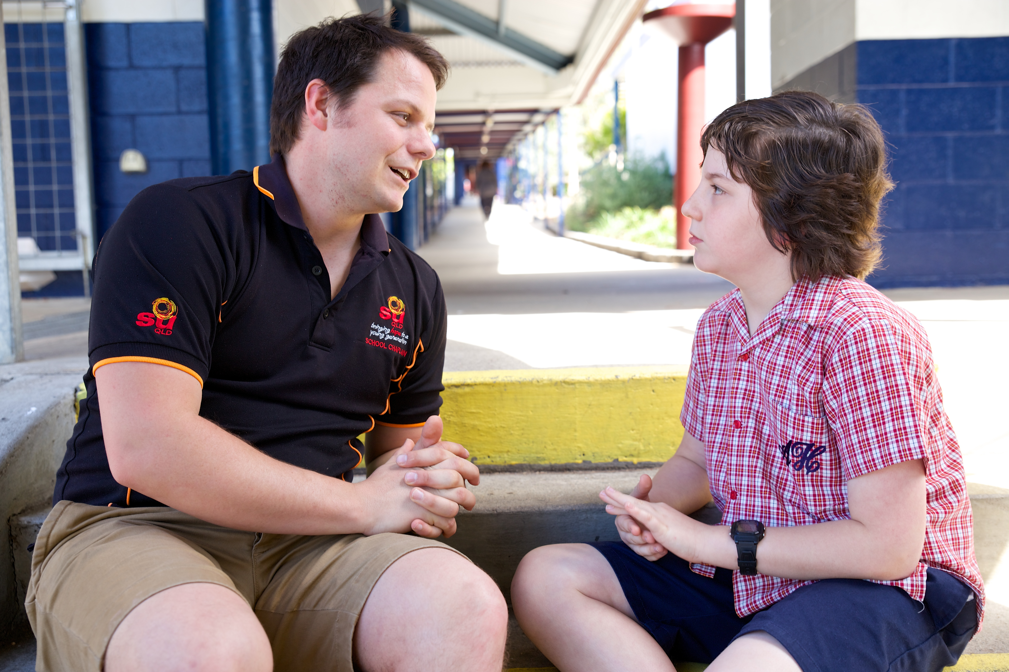
Chaplains provide proactive pastoral care for students, staff and parents, helping to create a positive and safe ^{school environment and looking} out for those in need. They support ^{students and the school} community through bereavement, family breakdown, peer relationships and other difficulties such as bullying, depression and suicide.

Slide 8
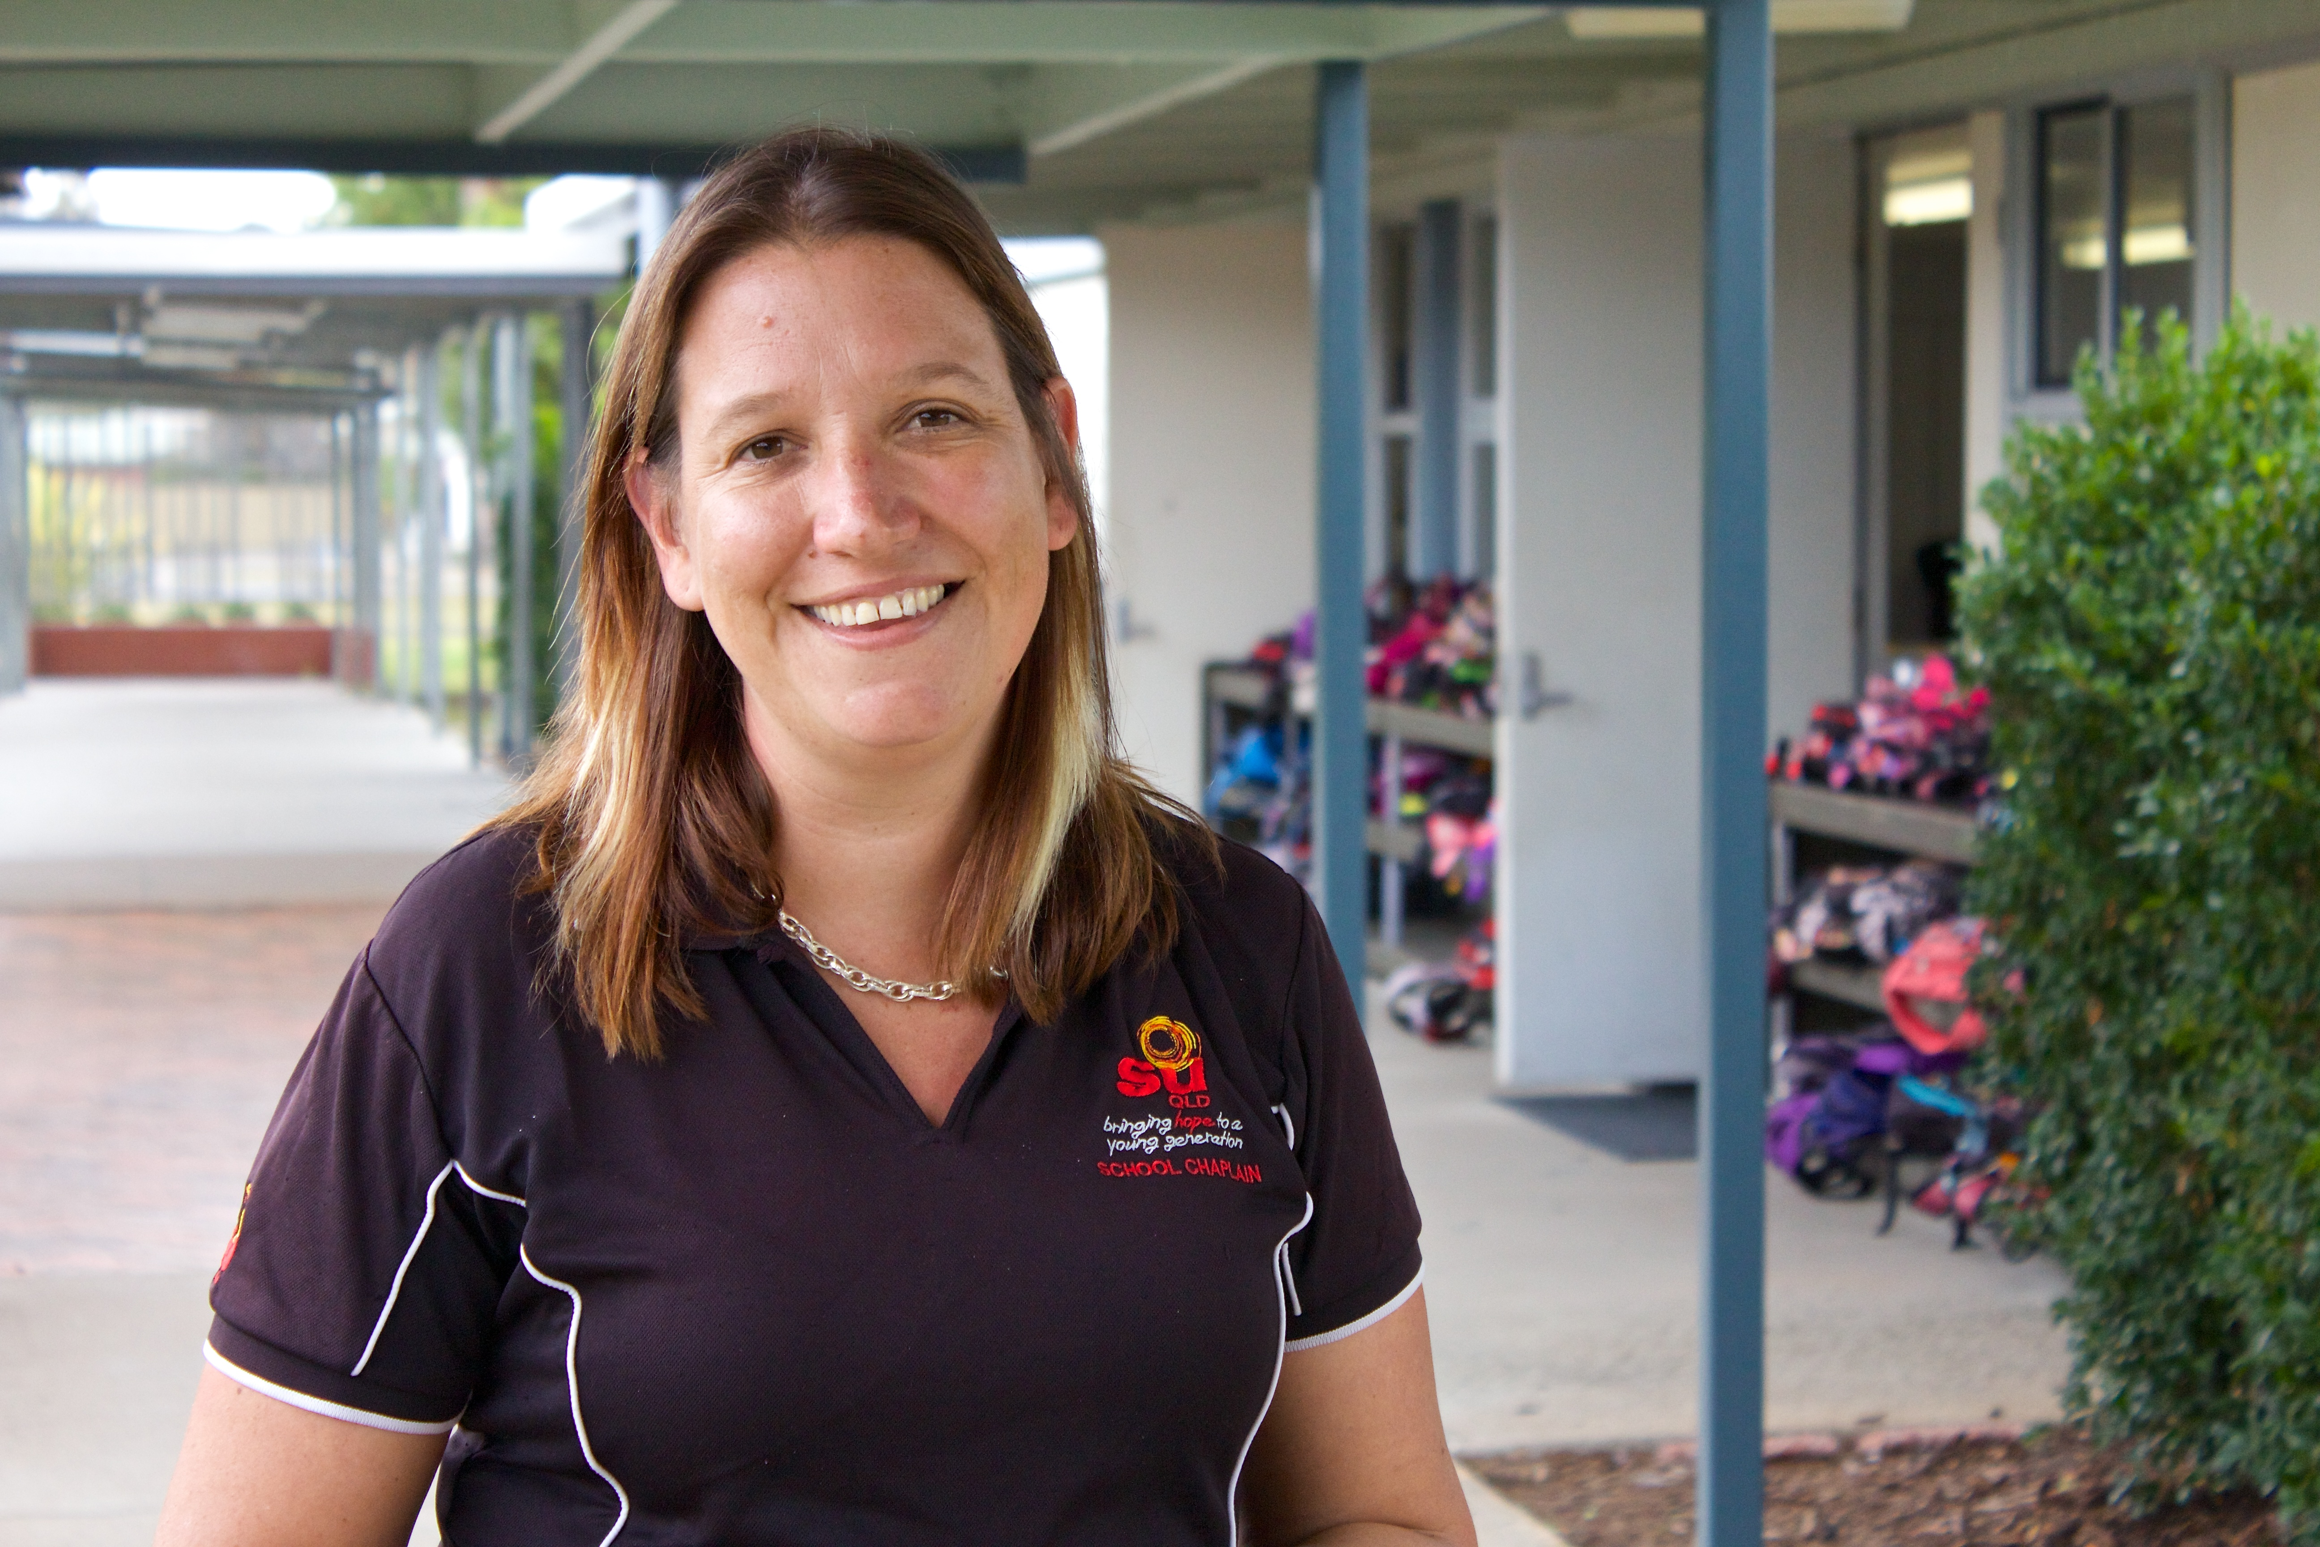
Chaplains provide an additional dimension to a school’s care by supporting the spiritual needs of students, regardless of their faith or beliefs. For students who seek it, chaplains can help them explore their worldview in relation to spirituality, values and ethics in a safe and respectful environment.

Slide 9
Chaplains act as role models for students, assisting them to develop ^{positive and} ^{supportive} ^{relationships.} ^{Chaplains may also implement} mentoring programs, utilising resources and volunteers from the ^{local community.}

Slide 10
Chaplains help to build strong links between the school and the wider community. They network with school-based support staff, community based organisations, churches and other networks to mobilise the resources of the community to support ^{student needs i.e.} ^{breakfast, shoes and uniforms.}

Slide 11
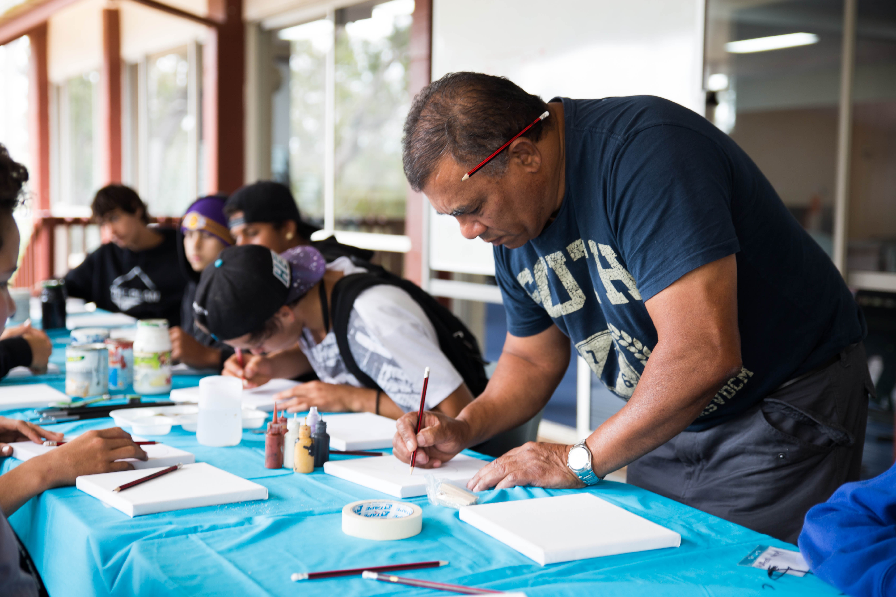
Chaplains participate in general school activities e.g. camps, excursions, sports day or coaching team sport. This may involve:
Participating in general school activities and contributing to building a positive school
^{environment.}
Developing voluntary activities for students that build a positive school culture and
enhance personal wellbeing for students.
Notes:
Possibly purple

Slide 12
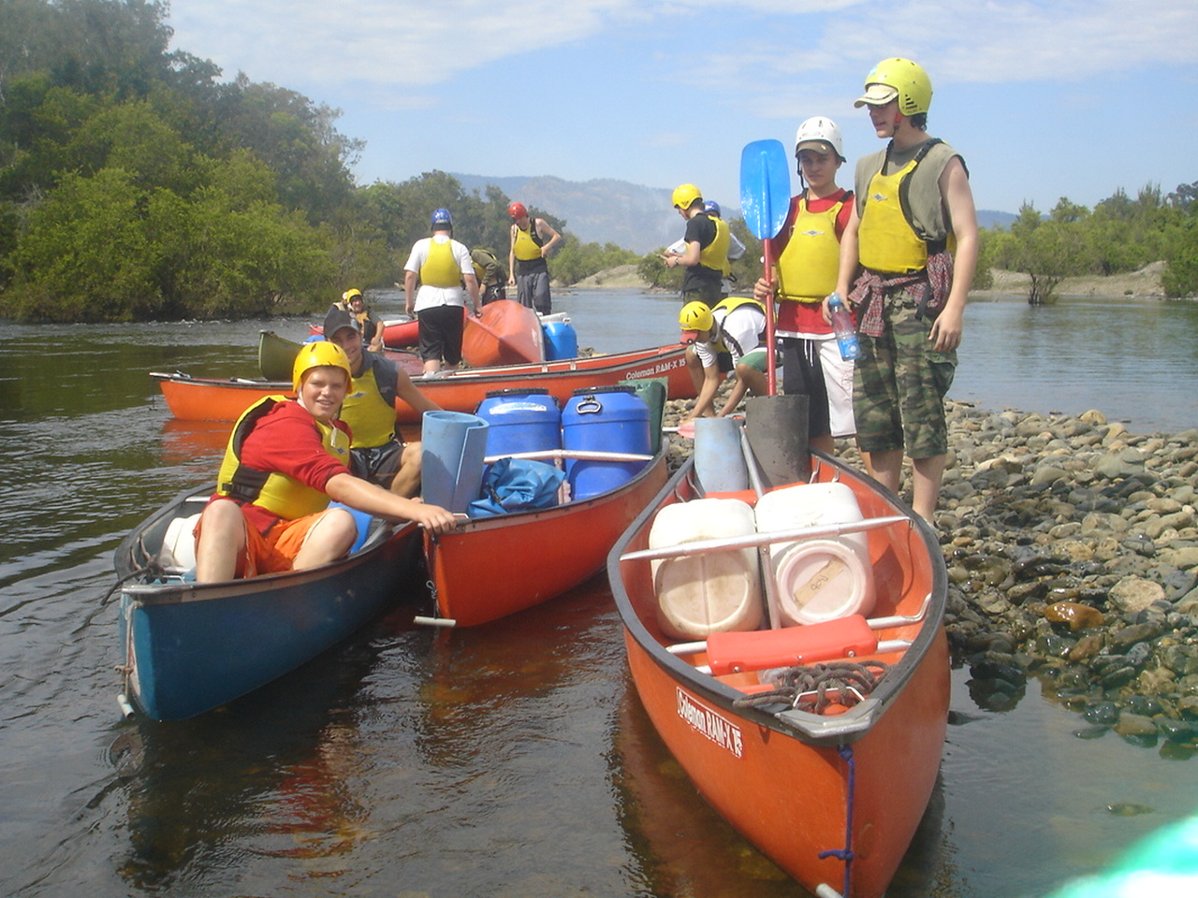
^{Chaplains support the learning} ^{environment through classroom} activities (under the direction of the teacher) and other structured ^{programs in order to provide} ^{further}
^{social, emotional or spiritual} support, particularly with students ^{at risk of} ^{disengagement.}
Notes:
Possibly purple

Slide 17
What chaplains do
-Breakfast Clubs
Please view video here: http://youtu.be/k_lArsIjRSI

Slide 18
“ Many Principals and others, including Members here, will attest to the value of chaplains in the recent events [2013 Bundaberg Flood]… Chaplains have certainly provided great support, not just in Bundaberg, but throughout the state.”
— Hon JP Langbroek, Minister for Education

Slide 19
“I’ve worked with children who face tough times in their lives, but I’ve also been there to celebrate their triumphs. The thing that I love most about chaplaincy is that it’s about journeying with young people and families. It’s about listening… just being there, without any agenda… and supporting them in any way I can.”
^{— Kirsty Ridgeway, Chaplain}

Slide 20
“I met up with my chaplain every week or just when I needed someone to speak to about my problems. It helped me a lot emotionally. I could keep my emotions under control when I was just with my mates but I couldn’t hold it in when I went to talk to my chaplain. Having someone to talk to, kept me from letting my anger out in class and in the playground.”
^{— Stuart, Student}

Slide 21
What chaplains do
-Lunch Programs
Please view video here:
http://youtu.be/nwDHDQaNJEU?list=UU-Cn4yGv4sFg4HadshohpVw

Slide 22
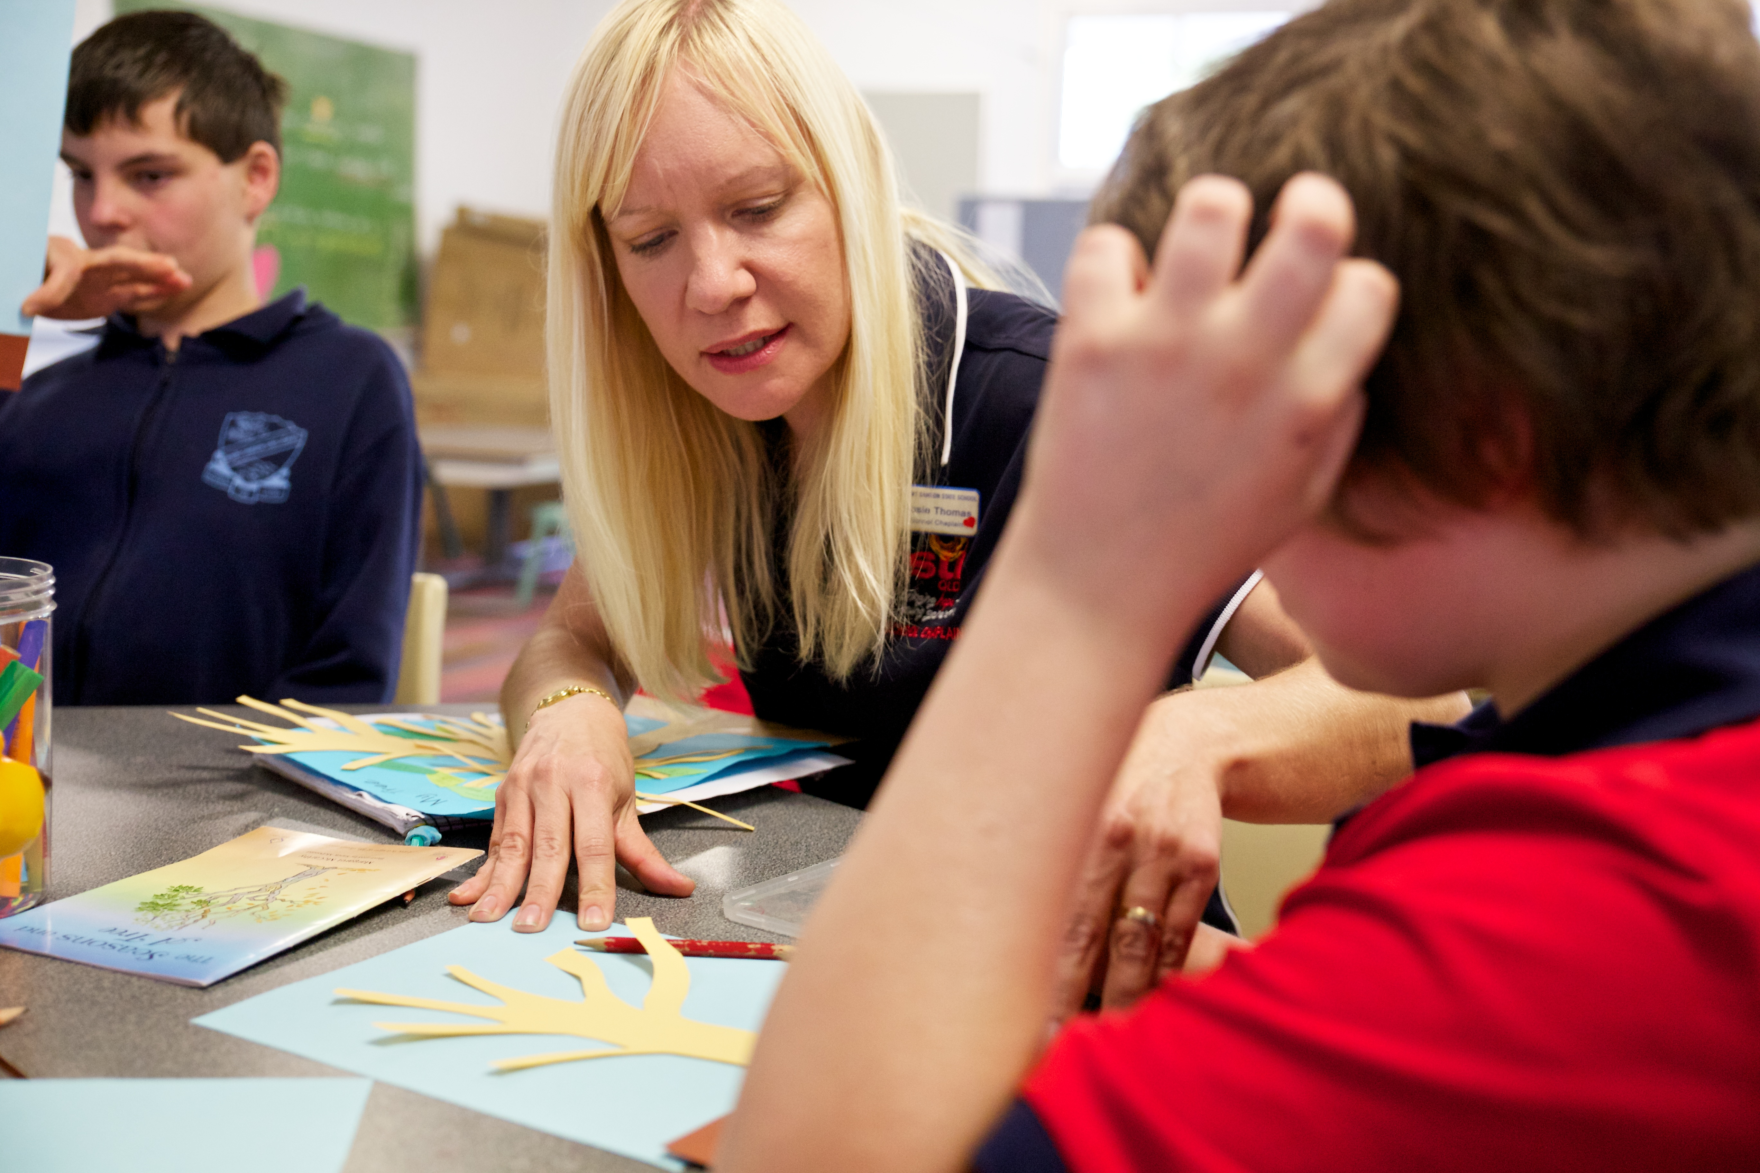
Funding Model
The federally funded National School Chaplaincy and Student Welfare program has been a great help, but not all school chaplains receive government funding… and it is important to note that the NSCP program is only meant to be a contribution towards the costs of a chaplaincy service.
To ensure local chaplaincy services remain sustainable, local community support is vital. SU QLD supports the initiative by appointing, training and equipping school chaplains.
Your support can help keep chappies in schools... and continue to bring hope to a young generation.

Slide 23
How you can help
The way a chaplain can get alongside a struggling student and support them through the everyday challenges of life is significant, and the impact is very real.. Chaplains embody the servant heart of Jesus giving children and young people the chance to see what ‘faith in action’ really looks like.
Your Church can support chaplaincy in a number of ways:
Provide a special once off gift
Provide a regular gift to help bring stability to the Chaplaincy Service
Volunteer to assist in running programs at your chaplain’s school e.g. breakfast club
Join the Local Chaplaincy Committee to help with a specific task e.g. secretary, treasurer, fundraising coordinator
Pray for the chaplain and the school community
Ask to receive the chaplain’s newsletter so that you receive the latest news about the Chaplaincy Service

